Slide 1

Convolutional Neural Network (CNN)

Slide 2
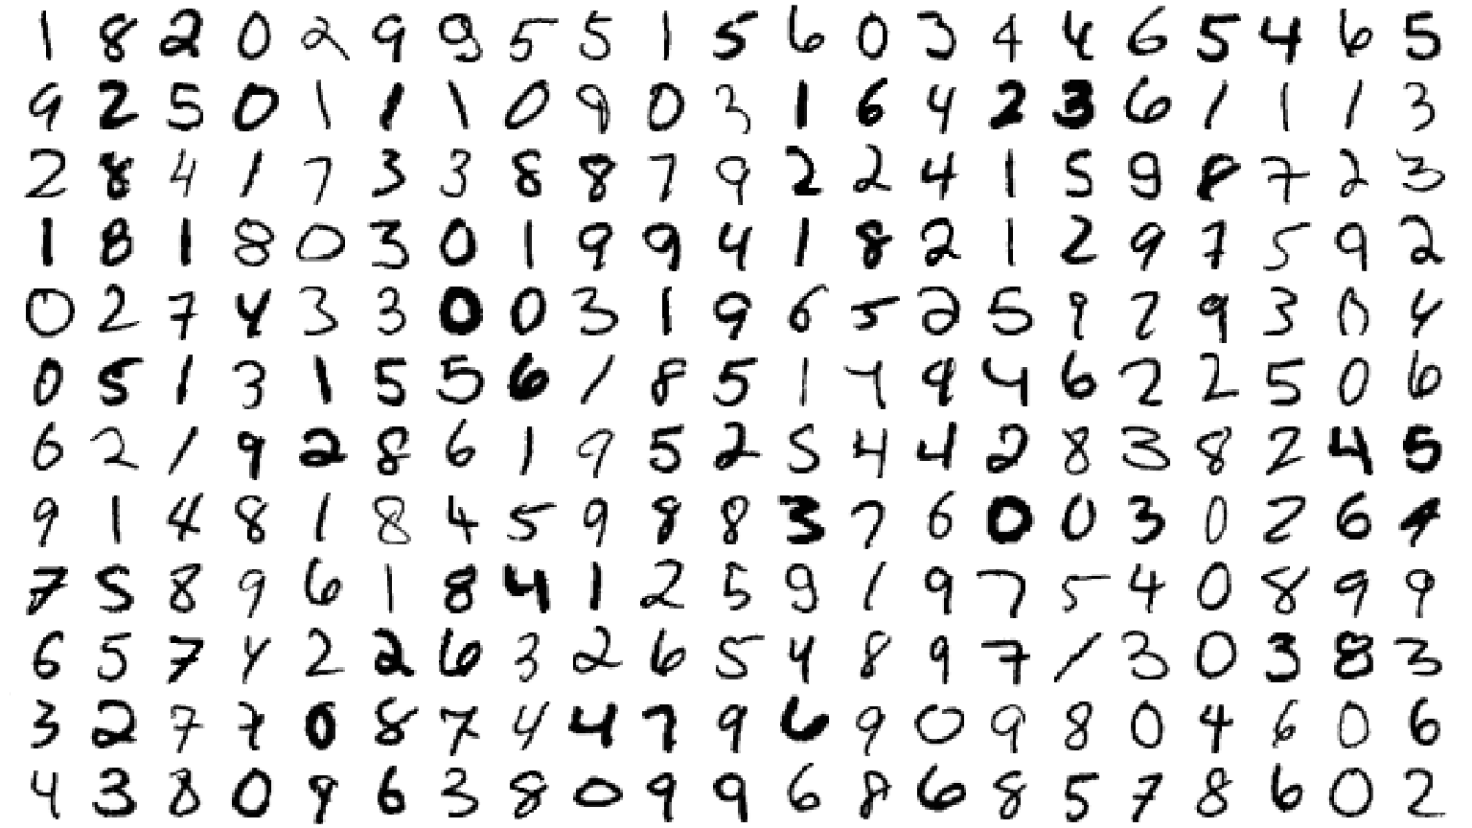
?
MNIST = Mixed National Institute of Standards and Technology - Download the dataset at http://yann.lecun.com/exdb/mnist/
Notes:
The MNIST dataset contains 60,000 handwritten digits labeled with their correct meaning. This dataset can be downloaded from: http://yann.lecun.com/exdb/mnist/

Slide 3

Working with real world data

Slide 4
How to organize image data?

Slide 5
Visualize image data
How to organize image data?

Slide 6
Visualize image data
How to organize image data?
Loading Images for training

Slide 7
Working with different image Sizes
Visualize image data
How to organize image data?
Loading Images for training

Slide 8
Working with different image Sizes
Visualize image data
How to organize image data?
How to get more data for training?
Loading Images for training

Slide 9
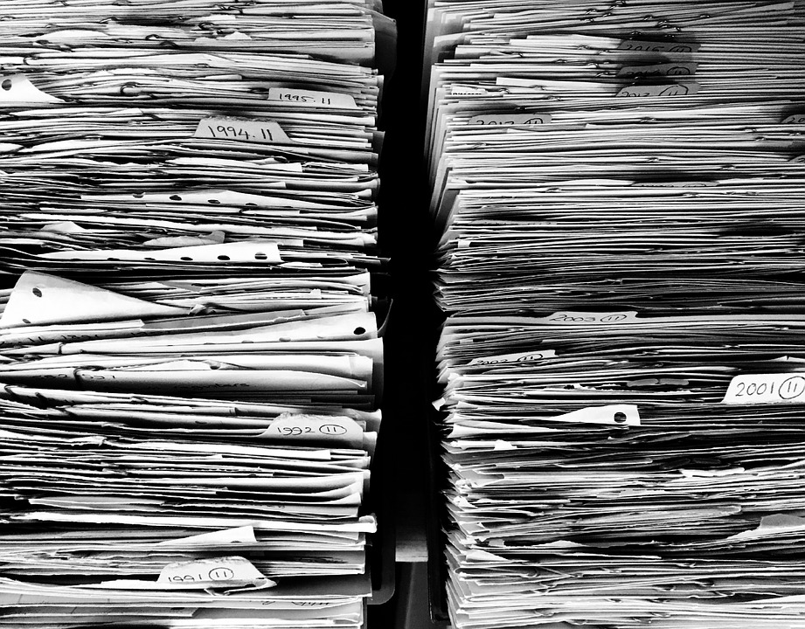
How to organize Image Data

Slide 10
Image files
Class # 1 folder
Class # 2 folder
Training_data folder
Class # 3 folder
Class # 4 folder
Class # 5 folder
main_folder
Class # 1 folder
Class # 2 folder
. . .
Test_data folder
Class # 3 folder
. . .
Class # 4 folder
. . .
Class # 5 folder
. . .

Slide 11
Image files
Class # 1 folder
Class # 2 folder
image_data folder
Class # 3 folder
Class # 4 folder
Class # 5 folder
Another approach

Slide 12
CSV File
Another approach
Store info about folder/images/Classes in csv file

Slide 13
Let’s work with some ‘real’ data
Flowers dataset

Slide 14

What data exploration can we do with image data?
Visualize the data and make sure data is appropriate for the task and labeled correctly.

Slide 15
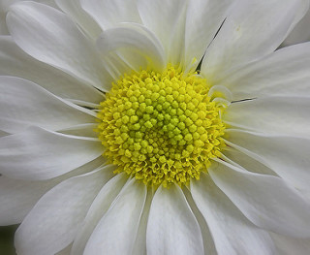
Visualizing image
We can use Keras image class

Slide 16
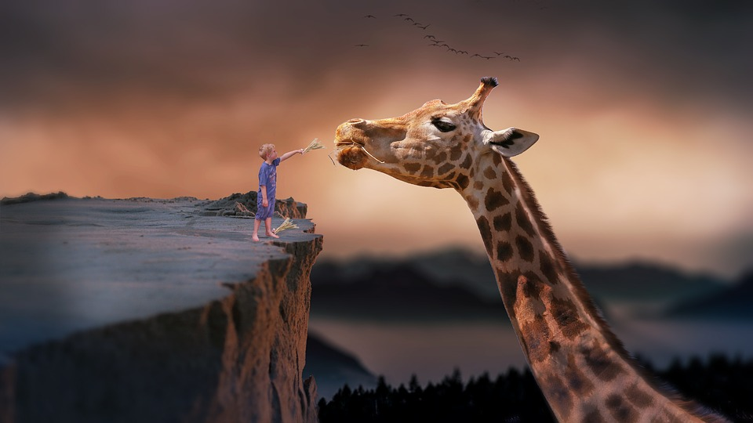
How to feed images for training

Slide 17

Daisy
Read image from disk
Resize image,
if needed
Convert image data to Numpy array
Neural Network
Dandelion
Rose
Sunflower
Tulip

Slide 18
Daisy
Read image from disk
Resize image,
if needed
Convert image data to Numpy array
Neural Network
Dandelion
Rose
Sunflower
Tulip
This can be done by Keras Image module

Slide 19
We usually have 1,000s of Images available on Disk

Slide 20
1,000s of Images available on Disk
Loading all images at once in our program can result in…
Memory Error!!!

Slide 21
How do we avoid loading all the images in memory … and still train the model?
Do we need all images for training at given time?

Slide 22
1,000s of Images available on Disk
Number of Images to be loaded in memory at once
= batch size

Slide 23
1,000s of Images available on Disk
Read fixed number of images at one time
Number of Images loaded in memory at once
= batch size

Slide 24
1,000s of Images available on Disk
Read fixed number of images at one time ...needs a function
Read images for every batch from disk
Resize the images
Convert images to numpy arrays
Prepare labels
Run as long as model trains
Number of Images loaded in memory at once
= batch size

Slide 25
How do we build such a function?
We can use python generators!

Slide 26
What is a python generator?
Let’s check in the code!

Slide 27

Good news :)
Keras has a pre-built batch generator for images
ImageDataGenerator

Slide 28
Exercise
Building an image classifier using ImageDataGenerator

Slide 29
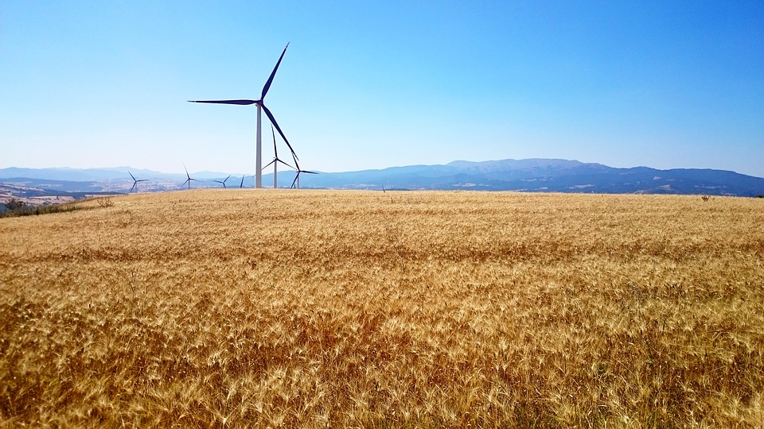
How do we get more data?

Slide 30
Image Augmentation
Creating more images from existing Image

Slide 31
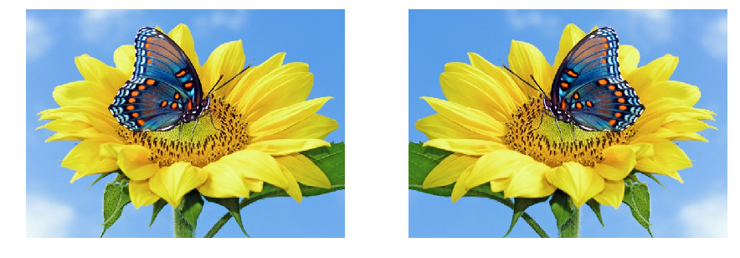
Original image
New image
Horizontal flip

Slide 32
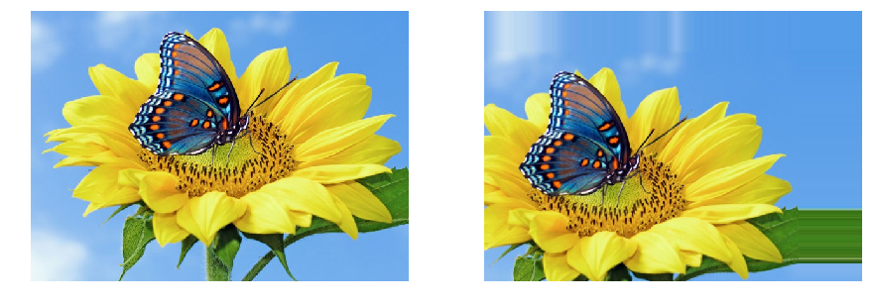
Original image
New image
Shifting image randomly

Slide 33
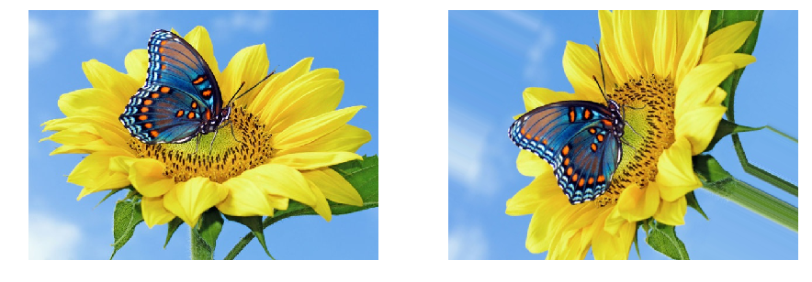
Original image
New image
Rotating image randomly

Slide 34
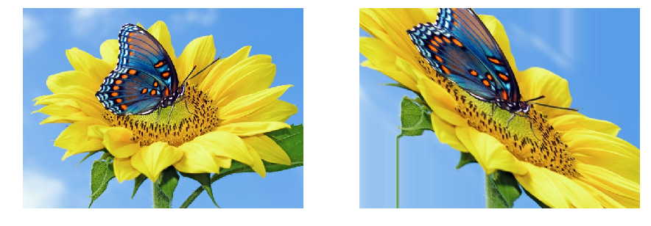
Original image
New image
Shearing image

Slide 35
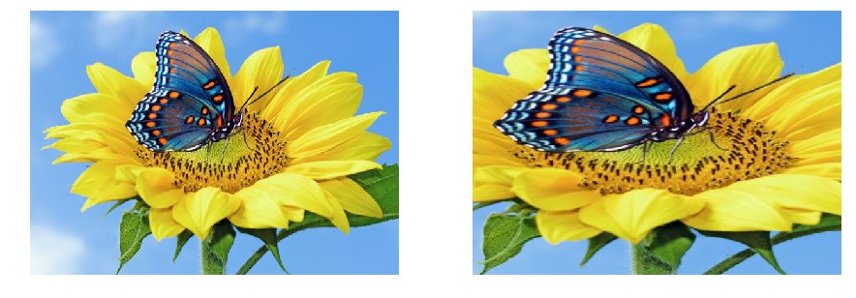
Original image
New image
Zoomed image

Slide 36
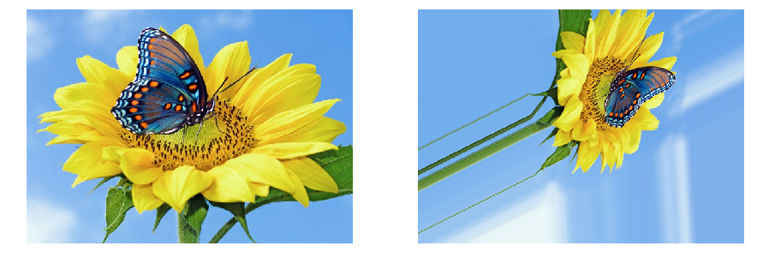
Original image
New image
Multiple transformations at once

Slide 37
Image Augmentation using
ImageDataGenerator

Slide 38
Exercise
Building an Image classifier using Image Augmentation

